Slide 1
Chapter 4 Induction and Recursion

Slide 2
Recursion - Summary
Recursive definitions
Sequences, functions
Sets
Recursive Algorithms
Fibonacci numbers
Binary search
Merge sort

Slide 3
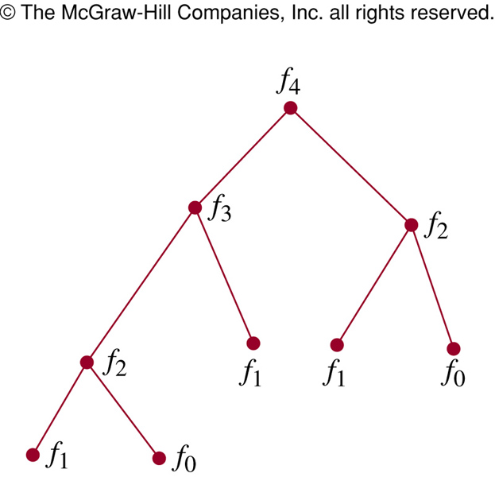
Recursion and Iteration
procedure rfibo (n: nonnegative integer)
if n=0 then rFibo(0)=0
else if n=1 then rFibo(1)=1
else rFibo(n) := rFibo(n-2) + rFibo(n-1)
procedure iFibo (n: nonnegative integer)
if n=0 then y:=0
else if n=1 then y:=1
else
x:=0 ; y:=1
for i:= 2 to n
z:= x+y
x:= y
y:=z
return(z)
{ iFibo(n) = z}
Recursive algorithm uses far more computation than iterative one
Notes:
To find the Fibonacci f_{n}, the recursive algorithm this algorithm requires f_{n+1} -1 additions.
Only n -1 additions have been used to find f_{n} with the iterative approach.

Slide 4
Induction - Objectives
Mathematical Induction (two steps)
Basis step
Inductive step
Strong Induction

Slide 5
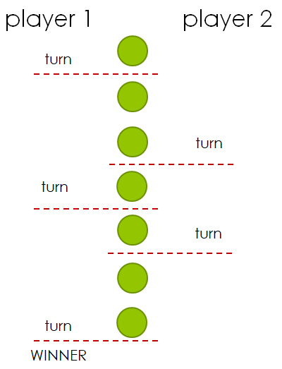
Game of Nim
Game starts with one pile (column) of n peanuts (or objects)
2-player game
Both players take turns
On each turn, a player removes one or two peanuts
The player who removes the last peanut is the winner

Slide 6
Game of Nim
n = 4 player 1 player 2
turn
turn
turn
WINNER

Slide 7
Show that if n = 3k + 1, then the player who plays first will be the winner of the game.
➔ Mathematical induction can help

Slide 8

Induction - idea
How to arrange dominos?

Slide 9
100
∞
p[1] = True
for k:=1 to 10 do
if (p[k] = True) then
p[k+1] = True
print p
What is the result?

Slide 10
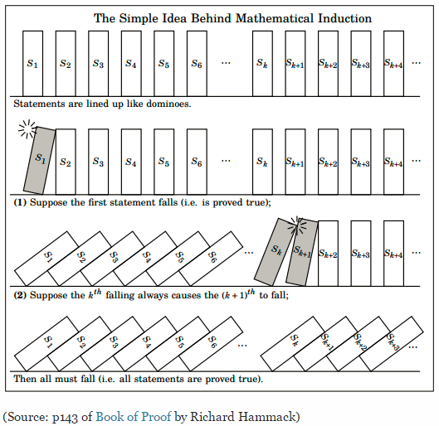
Mathematical Induction
Domino Arrangement and Mathematical Induction

Slide 11
Mathematical Induction
Basis step. Verify that P(1) is true
Inductive step.
Prove that P(k) → P(k+1) is true for all k ≥ 1
Prove that "n² + n is an even“ is true for every integer n > 0.
(1) Suppose for every integer k > 0, k² + k is even
(2) 1² + 1 = 2 is even
Make a correct order!
(3) Therefore, the statement is true.
(4) We have,
(k+1)² + (k+1) = k² + 2k + 1 + k + 1
= k² + k + 2(k+1).
This sum is even.

Slide 12
Induction: Example 1
Prove that 1 + 2 + 3+ …+ n = n(n+1)/2 for all integers n>0
Basis step:
Inductive step: With arbitrary k > 0, suppose
is true.
So
1+2+3+…+k+(k+1)
= (k+1)(k+2)/2
Proved.
the smallest value of n (n=1)
easy
?
“1 = 1(1+1)/2” ➔ true
P(1) is true
?
easy
“ 1+ 2+…+ k = k(k+1)/2”
P(k)
Do some math skills
= k(k+1)/2 + (k+1)
?
= [k(k+1)+ 2(k+1)]/2
P(k+1)
Notes:
Note that P(n) is entire equation, it is not only the left-hand side of the statement 1+2+3+…+ n = n(n+1)/2.

Slide 13
Show that
2^{n} < n! for n ≥ 4
Basis step: 2⁴ < 4! ➔ True
Inductive step: With arbitrary k ≥ 4, suppose
2^{k} < k! is true.
So
2^{k+1} = 2.2^{k} < 2.k! < (k+1)k!
➔ 2^{k+1} < (k+1)!
Proved.

Slide 14
Exercise
Given the algorithm
procedure tinh(n : non-negative integer)
if (n = 0) return 1
else return n*tinh(n-1)
1/ Whats is the result after calling tinh(5)?
2/ Using induction to prove that tinh(n) can be used for computing n! for every positive integer n.

Slide 15
Show that
tinh(n) = n! for n ≥ 0
Basis step: tinh(0) return 1 = 0! ➔ True 1 đ
Inductive step: With arbitrary k ≥ 0, suppose
tinh(k) return k! 2 điểm
So, k ≥ 0 ➔ k + 1 ≥ 1
tinh(k+1) return (k+1)*tinh(k)
return (k+1)*k! = (k+1)! 2 điểm
Proved.

Slide 16
Prove that 1+3+5+…+(2n-1)= n², n ≥ 1
easy
Proof.
- Basis step. “1=1²” is true.
- Inductive step.
Suppose for every k > 0, P(k) is true. That is,
1+3+5+…+(2k-1) = k²
We have, 1+3+5+…+(2k-1) + (2k+1)
= k² + 2k+1
= (k+1)².
Proved.
easy

Slide 17
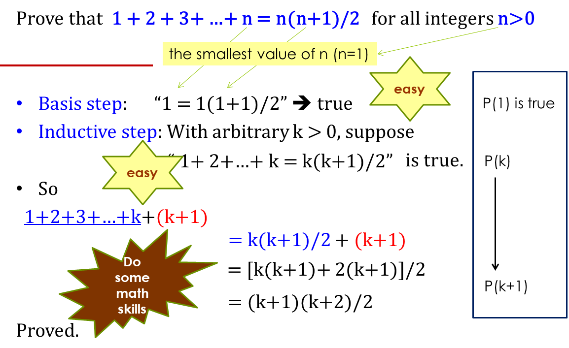
Do yourself
Show that
2⁰+2¹+2²+2³+…+2^{n} = 2^{n+1} -1, n = 0, 1, 2
Notes:
- Students are required to doing/reading these examples as exercises at class.

Slide 18
Strong Induction
Principle of Strong Induction
Basic step:
Verifying P(1) is true
Inductive step:
Show that [P(1) ^ P(2) ^ … ^ P(k)] → P(k+1)
is true for all k > 0

Slide 19
Prove that every amount of postage of 12 cents or more can be formed using just 4-cents and 5-cents stamps.
P(12): 12 = 3.4 + 0.5 // true
P(13): 13 = 2.4 + 1.5
P(14): 14 = 1.4 + 2.5
P(15): 15 = 0.4 + 3.5
P(16): 16 = 4.4 + 0.5
P(17): 17 = 3.4 + 1.5
P(18): 18 = 2.4 + 2.5
How about “k+1 cents = k-3 cents + 4 cents”?
For example, 22 = 18 + 4
OK
OK
OK

Slide 20
Basis step: P(k) is true for k = 12, 13, …, 15, 16
Inductive step:
Suppose P(12), P(13), …, P(k) are true for k > 15
We have
k + 1 = (k – 3) + 4
OK OK OK
By the assumption, P(k-3) is true
So, P(k+1) is true.

Slide 21
Strong induction. Example 2
Prove that if n is an integer greater than 1, then n can be written as the product of primes
P(n) : n = prime × prime × … × prime
P(2): ? // true
P(3): ? // true
P(4): ? // true
P(5): ? // true
P(11): ? // true
P(12): ? // 12 = 3.4 ➔ true
P(k) → P(k+1): ?

Slide 22
Strong Induction: Example 1
P(n) : n can be written as the product of primes
Basis steps: P(2) = true // 2=2 , product of 1 primes
P(4) = true // 4=2.2
Inductive step:
Assumption: P(j)=true for all positive j ≤ k
Case k+1 is a prime ➔ P(k+1) =true
Case k+1 is a composite
➔ k+1 = ab, 2 ≤ a ≤ b < k+1
OK OKOK
P(k+1) is true
Proved.

Slide 23
Review
Basis step. Verify that P(1) is true
Inductive step.
Prove that P(k) → P(k+1) is true for all k ≥ 1
Basis step. Verify that P(1) is true
Inductive step.
Prove that P(1), P(2), …, P(k) → P(k+1) is true for all k ≥ 1
Prove that
2^{n} < n! for all integers n > 3
For all integers n ≥ 4, n = 2a + 5b for some integers a, b ≥ 0.

Slide 24
Homework
procedure f(n: nonnegative integers)
if n = 0 then f(n): = 1
else f(n) = n*f(n-1)
Use mathematical induction to prove that the algorithm can be used for computing n! for all nonnegative integer n.

Slide 25
THANKS

